Slide 1


Slide 2
The Lowdown
“Chess with guns”
3D
Cooldown based
Multiplayer (PvP)
Notes:
3D – three.js, playable in browser

Slide 3
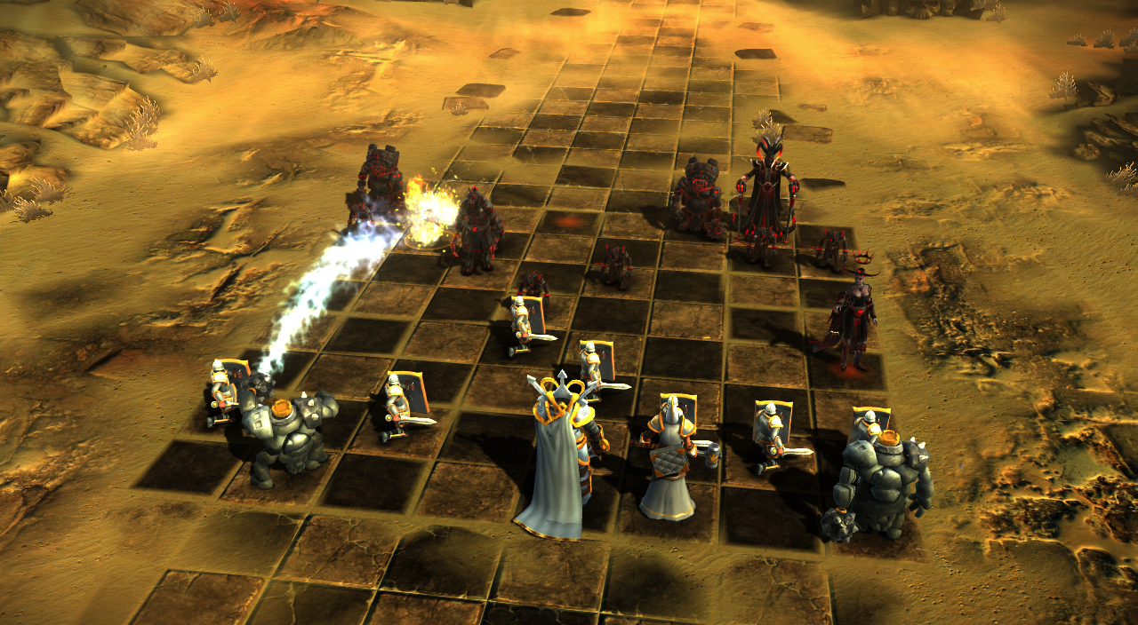
Notes:
Inspiration: battle chess

Slide 4
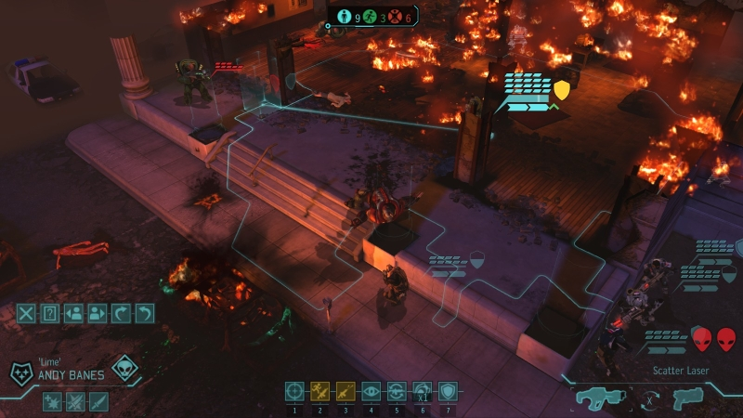
Notes:
Inspiration: XCOM

Slide 5
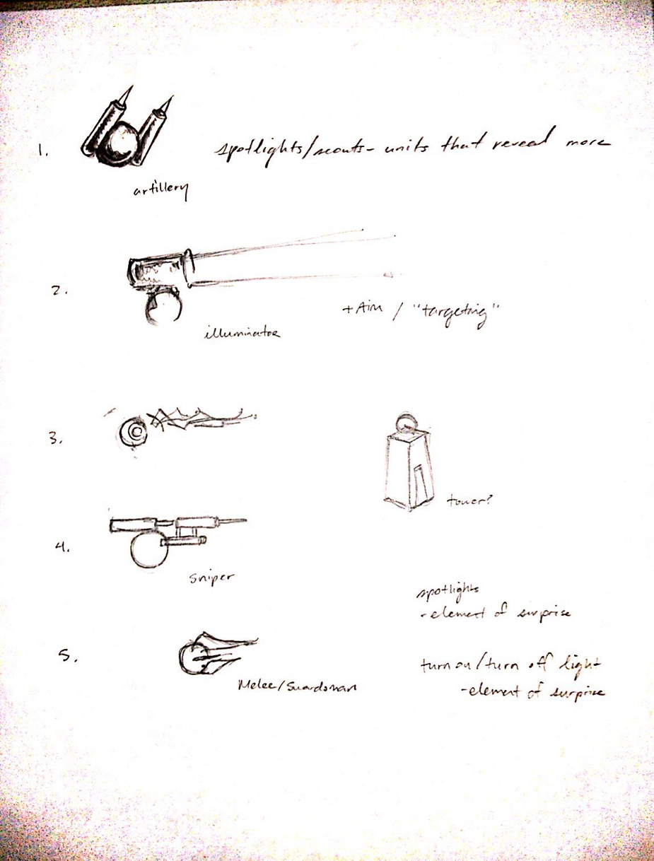
Features
Units with different classes
Fog of war
Line of sight

Slide 6
Art style
Notes:
Game ideas

Slide 7
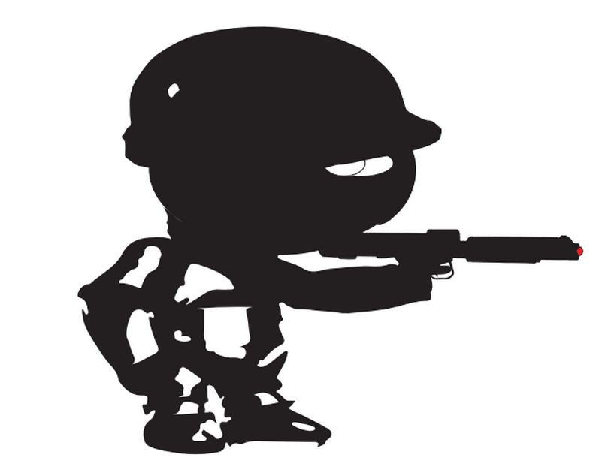
Notes:
Concept art goes here

Slide 8


Slide 9


Slide 10


Slide 11



Slide 12




Slide 13


Networking
Node.js: client – server communication
Host on Nodejitsu

Slide 14



Network
Nodejitsu
Connect & Wait
Node.js
Socket.IO
Express
Jade
Sync & Packet exchange (movement)
Authority
Compute and send the game state

Slide 15
Roles
Peter Chang, Matt Zhao – game architecture, game logic
WenXuan Cai - networking
Matt Kerkstra – game art

Slide 16
Notes:
Demo time

